Slide 1
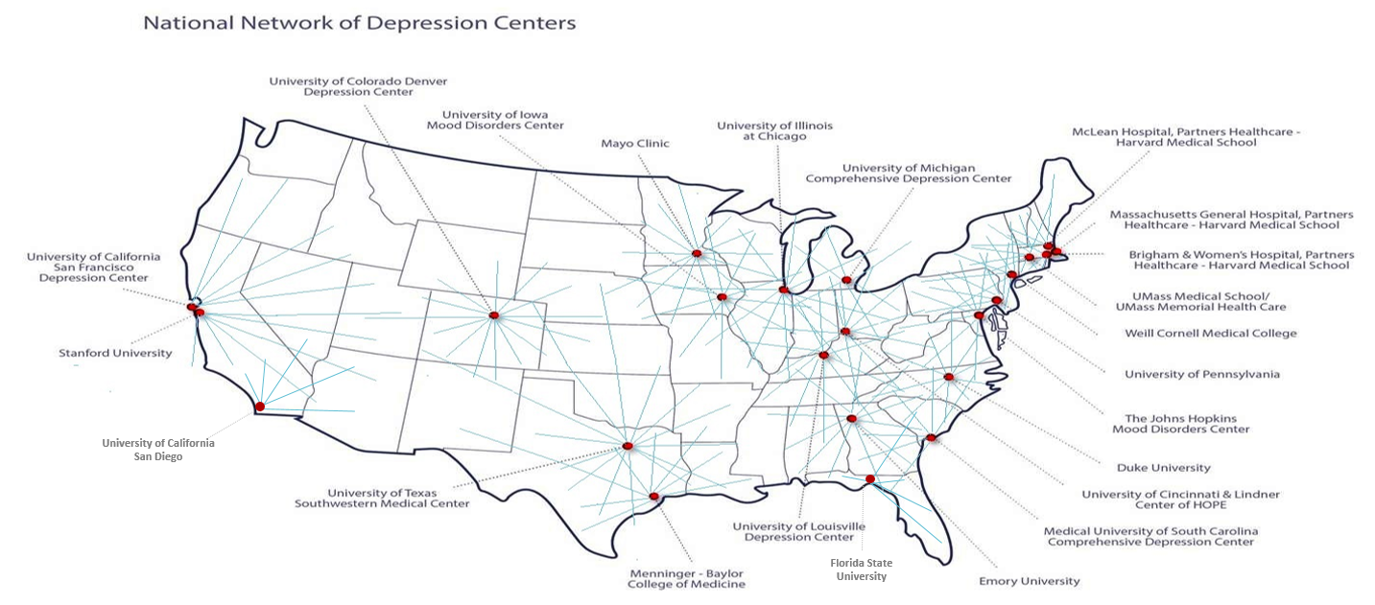
National Network of Depression Centers (NNDC) A Pre-Competitive Network to Develop Personalized, Precision Treatments for Depressions and Bipolar Illnesses 4th Annual One Mind Summit May 28, 2015
John F. Greden, M.D.
Rachel Upjohn Professor of Psychiatry and Clinical Neurosciences Executive Director, University of Michigan Comprehensive Depression Center
Founder and Chair, National Network of Depression Centers (NNDC) Research Professor, Molecular and Behavioral Neuroscience Institute
Past President, Board of Directors, American Foundation of
Suicide Prevention
No Conflicts to Report
Notes:
I’m going to briefly present on the National Network of Depression Centers, a Network of 23 Centers of Excellence in the United States collaborating to tackle the world-leading burdens of Clinical Depressions, Bipolar Illnesses, and related disorders. I will start with a bit about these mood disorders… their causes… why we don’t have personalized, precise treatments and what it will take to develop them… the progress that has been made… the barriers… and a vision for the future.

Slide 2
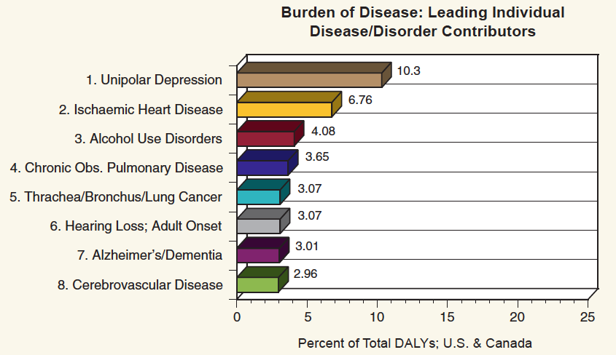
Depressions and Bipolar Illnesses Lead the World in Disabilities, Burdens and Costs
Suicide Death Rates Have Not Improved, Even Increasing
Why? 1 of every 6 people, youthful onset, recurrent, chronic course, complex genetics, underdiagnosed, and a more important reason that I will tell you about
75% - 80% of suicide deaths linked with depressions
Notes:
This is a picture of Tom Insel, although not from yesterday. His comment from a few years ago still exists today: the WHO categorizes Unipolar Depression as #1, #1 in Global Burden of Disease. Heart Disease is a distant second place. CLICK AND, since 75-80% of deaths by suicide are linked with mood disorders—depressions and bipolar illnesses—is it a surprise that since we have not made progress in reducing the burdens of depressions and bipolar illnesses we have not made progress in reducing suicide rates. In fact, in some age ranges there have been increases. WHY??

Slide 3
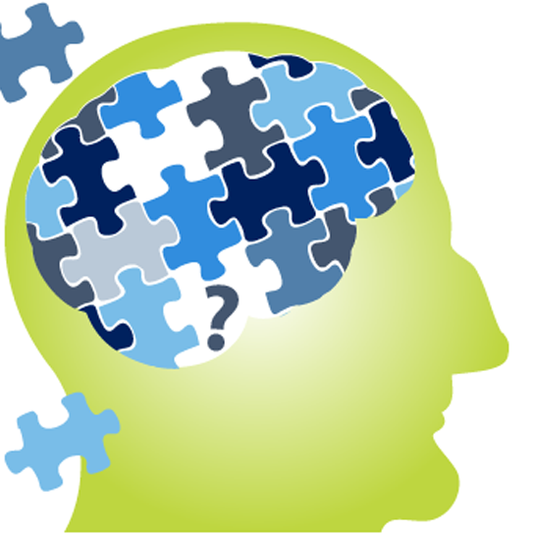
Key Reasons:
Multiple Causes and Co-Occurrences
Brain Genetic, Epigenetic, Pharmcokinetic, Pharmacodynamic and Neural Circuitry alterations
Serotonin, Norepinephrine, Dopamine, Acetylcholine, Glutamatergic (Ketamine), mu-opioids, etc.
Neurotrophins: BDNF, FGF, NGF, FGF2, etc.
Stress-neuroendocrine HPA abnormalities, hypercortisolemia
Chronophysiology (Biological rhythms) and clock gene dysregulation
Sleep apnea
Inflammatory: interleukins, cytokines
IL-1, IL-6, TNF-alpha, CRP, etc.
Traumatic Brain Injury (TBI, mTBI)
Epilepsy, seizure disorders
Post-Traumatic Stress (PTS)
Alcohol and Substance Abuse
Brain Developmental Disorders, e.g., autism
Brain Degenerative Disorders
Alzheimer’s, Parkinson’s, Multiple Sclerosis
Brain pain regulatory circuits altered
Cancers, Diabetes, Cardiovascular Illnesses (“Inflammatory”?)
Nutritional/metabolic dysregulation
Insulin Resistance
Folate, Vitamin D deficiency,
Tryptophan deficiencies
Microbiome alterations?
Others…
Notes:
A relatively unknown key reason is that we don’t have a “depression” or a “bipolar illness.” We have “DEPRESSIONS” AND “BIPOLAR ILLNESSES.” There are multiple causes. Start in the blue box and read rapidly…(COMMENTS)…Now read the box on the right side. These are major topics of interest in One Mind, and other members of this panel are experts. Every item in both boxes can produce a depression phenotype… Every one…AND THEY CO-OCCUR. THEY CAN BE A DIAGNOSIS OR A RISK VARIABLE FOR ONE ANOTHER. And many don’t do well with treatments…WHY?

Slide 4
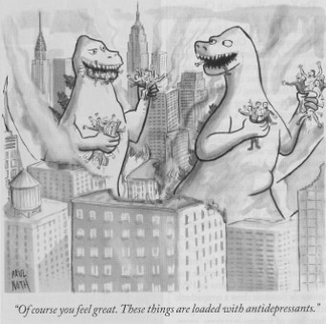
“One-Size Treatment’ Will Never Fit All…”
CURRENT SITUATION
FUTURE EXAMPLE
“Of course you feel great! These things are loaded with antidepressants”
Anti-Inflammatory treatments “personalized” for selected appropriate patients
Notes:
“ONE-SIZE TREATMENT WILL NEVER FIT ALL.” But our clinical delivery system does not reflect these multiple causes. In the future, hopefully aided by One Mind’s efforts to find biomarkers to identify different causes, we will improve this situation. CLICK. WE NEED PERSONALIZED, PRECISE TREATMENTS…WHAT WORKS FOR THE CAUSES THAT PRODUCE MY CLINICAL SYNDROMES. IT IS LIKELY THAT SOME OF THOSE WILL TARGET WHAT WE HAVE BEGUN TO CALL “INFLAMMATORY DEPRESSIONS.”

Slide 5
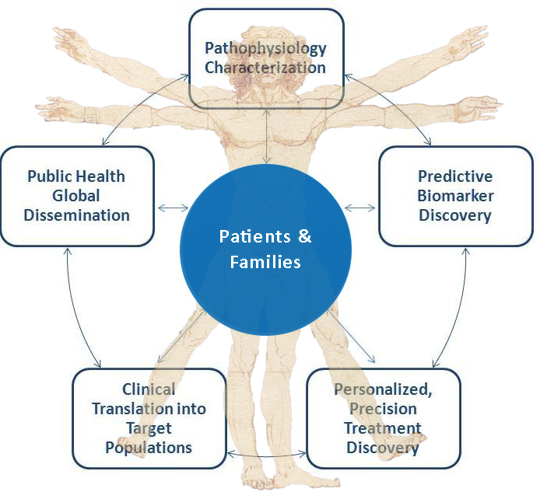
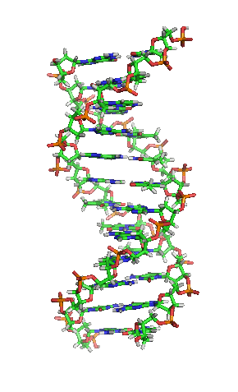
Networks and Precompetitive Collaborations are Essential for Personalized, Precise Treatment
Research to understand the
multiple causes
“Open Science” across the entire world
Lab tests to tell
them apart
Delivering the right
treatments to the right
people at the right time
Clinical Trials to tell
which treatments work
for which cause(s)
Notes:
LET’S LOOK AT WHY WE NEED INTERDISCIPLINARY, COLLABORATIVE CENTERS, PRECOMPETITIVE COLLABORATIONS, NETWORKS, LARGE SAMPLES , LONGITUDINAL MONITORING, AND OPEN SCIENCE IF WE ARE TO DEVELOP PERSONALIZED, PRECISE TREATMENTS.
(RAPID CLICKS)
NOTE THAT ARROWS GO IN BOTH DIRECTIONS. IN SOME CASES, CLINICAL RESPONSE SHOULD SUGGEST BIOMARKER STUDIES THAT LEAD TO UNDERSTANDING THE UNDERLYING BRAIN PROBLEMS

Slide 6
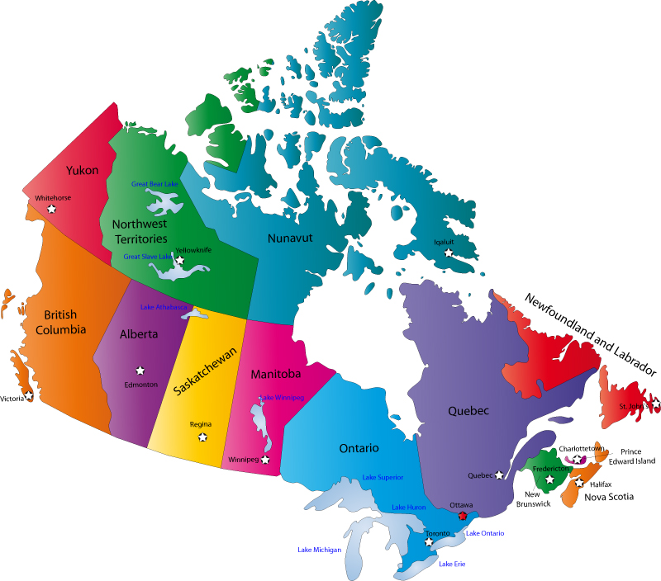
National Network of Depression Centers Launched in 2009 with 16 Centers, now 23 ; Six New Centers in Canadian Depression Research Intervention Network (CDRIN)
CDRIN: Canadian Depression Research Intervention Network
23 Centers in USA,
500+ members
6 in Canada
“A Center of Excellence for Mood Disorders within 200 miles of every person”
Notes:
SO, TO TACKLE THIS, THE UNIVERSITY OF MICHIGAN ESTABLISHED A COMPREHENSIVE DEPRESSION CENTER IN 2006, AND LED ESTABLISHMENT OF A NATIONAL NETWORK OF DEPRESSION CENTERS IN 2009. IT STARTED WITH 16, THERE ARE NOW 23, WITH MORE THAN 500 FACULTY, AND HUGE POTENTIAL CAPACITY, AND RECOGNIZING THE VALUE OF THE CONCEPT, CANADA HAS NOW STARTED 6 CENTERS. SO NOW THE NETWORK HAS THE POTENTIAL TO BE GLOBAL.

Slide 7
Proof of Concept: NNDC “Vital Signs” Registry Underway
NNDC Mood Outcomes Program
Goal: 10’s of thousands…millions in the future
Partnerships will be needed
Psychiatric Genetic Consortium?
Shared Biorepositories starting
Long-term measurement-based care an essential component for precise treatments
>1,500 patients
PHQ-9
GAD-7
C-SSRS
Altman Mania
Sleep
Substance Abuse
Partially supported by NIH CTSA (NCATS);
Current Partnership with Altarum Institute
Notes:
*NNDC MEMBERS HAVE PROOF OF CONCEPT: THAT THEY CAN COLLECT AND SHARE DEIDENTIFIED DATA AMONG MANY SITES AND HAVE DONE THIS ON 1500 PEOPLE AND GROWING WHO ARE BEING LONGITUDINALLY MONITORED OVER TIME.
*LONG-TERM FOLLOW-UP TRIALS ARE THE ONLY WAY…THE ONLY WAY…WE WILL GET TO PRECISION TREATMENTS. WE HAVE A GOAL OF A MILLION. IT IS ACHIEVABLE WITH HELP.
*SITE MEMBERS AGREED ON THE SAME SCALES. THEY STORED DATA FROM MORE THAN 1500 PATIENTS WITH SOME MODEST SUPPORT FROM CTSA, AND THEY HAVE PUBLISHED FROM THE DATA.
*PROBLEMS REMAIN, HOWEVER. SHARING A REGISTRY AND BIOREPOSITORY FOR DEIDENTIFIED DATA IS CONSIDERABLY EASIER THAN IT IS TO RE-IDENTIFY DATA AND CONDUCT CLINICAL TRIALS. THE IRB BARRIER IS A HUGE ONE. WE NEED UNIVERSAL IRB’S WITH IDENTIFIED INDIVIDUALS,. LET’S FOLLOW THE CANCER MODEL. WE DON’T HAVE IT AND WE PAY A PRICE FOR THAT.
*ALSO, THE DISCUSSION, I HOPE WE CAN TALK ABOUT HOW PARTNESHIPS AMOND ONE MIND INITIATIVES WILL HELP MAKE THAT DA VINCI DIAGRAM OF THE VITRUVIAN MAN COME TO LIFE.

Slide 8
“Ultimately, we will need to evaluate the most promising approaches in much larger numbers of people over longer periods.”
“Toward this end, we envisage assembling over time a longitudinal “cohort” of 1 million or more Americans who have volunteered to participate in research. ”
Open Science (One Mind for Research): A global movement to make scientific research, results and data available and accessible to everyone
Precompetitive Collaboration: Collaborating before competing to produce large registries and repositories
“Big Data”: Statistical Power, Replication, Validation, Breakthroughs and Biomarkers
Notes:
THERE IS HAPPILY A NEW PUSH ON A FEDERAL LEVEL TO PROMOTE PRECISION MEDICINE, BOOSTED BY SOME RATHER-POWERFUL VOICES: FRANCIS COLLINS, HAROLD VARMUS, THE PRESIDENT OF THE UNITED STATES, AND OF COURSE, THE MEMBERS OF ONE MIND. I WILL CLOSE BY BEING BOLD ENOUGH THAT SOME OF THE RESOURCES NEED TO GO TO THE MOST DISABLING BRAIN ILLNESSES AS WELL AS CANCER.
We have a roadmap. We need Public Private Partnerships , culture change and money for fuel to drive the vehicles. We can do this… (CLICK)

Slide 9
Collaborations + open science + longitudinal monitoring = A Brighter Future For Our Grandchildren!
Go Blue!
Ben thanks you!
gredenj@umich.edu
Notes:
My Grandson is optimistic. Ben thanks all of us for your collaborative efforts.

Slide 13
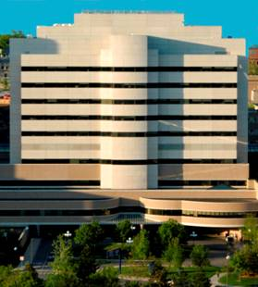
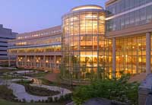
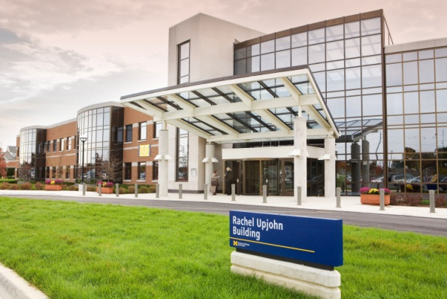
Breaking Through Barriers To Collaboration And Open Science
Selected Barriers - “Silos” - “Publish or Perish” - Money and Competition - Short-term grants - No common measurements - Acceptable sharing agreements
Possible Solutions - “Translation” is required - “Partner or perish” - Prioritize Collaborative Networks - Follow-up and sustainability - IOM endorsement ? - IOM Guidelines ?
A NEW ERA
“Center-to-Center (C2C) Collaborations” Addressing Co-Occurrence of Most Disabling Medical Illnesses
Cardiovascular Center
Cancer Center
Depression Center

Slide 14
Depressions and Bipolar Illnesses:
Leading Brain Illnesses Around the Globe
THE FACTS:
Afflicts 1 out of every 6 people around the world
IMPACTS ALL: friends, family, colleagues, communities
$210.5 Billion annual economic burden in the US alone
Peak onset between 15-24 years of age
Episodic, recurrent lifetime course
Multiple Causes
Altered brain neurogenesis with chronicity…

Slide 15
National Network of Depression Centers Launched in 2009 with 16 Centers, now 23 and New Associate Memberships

